Slide 1
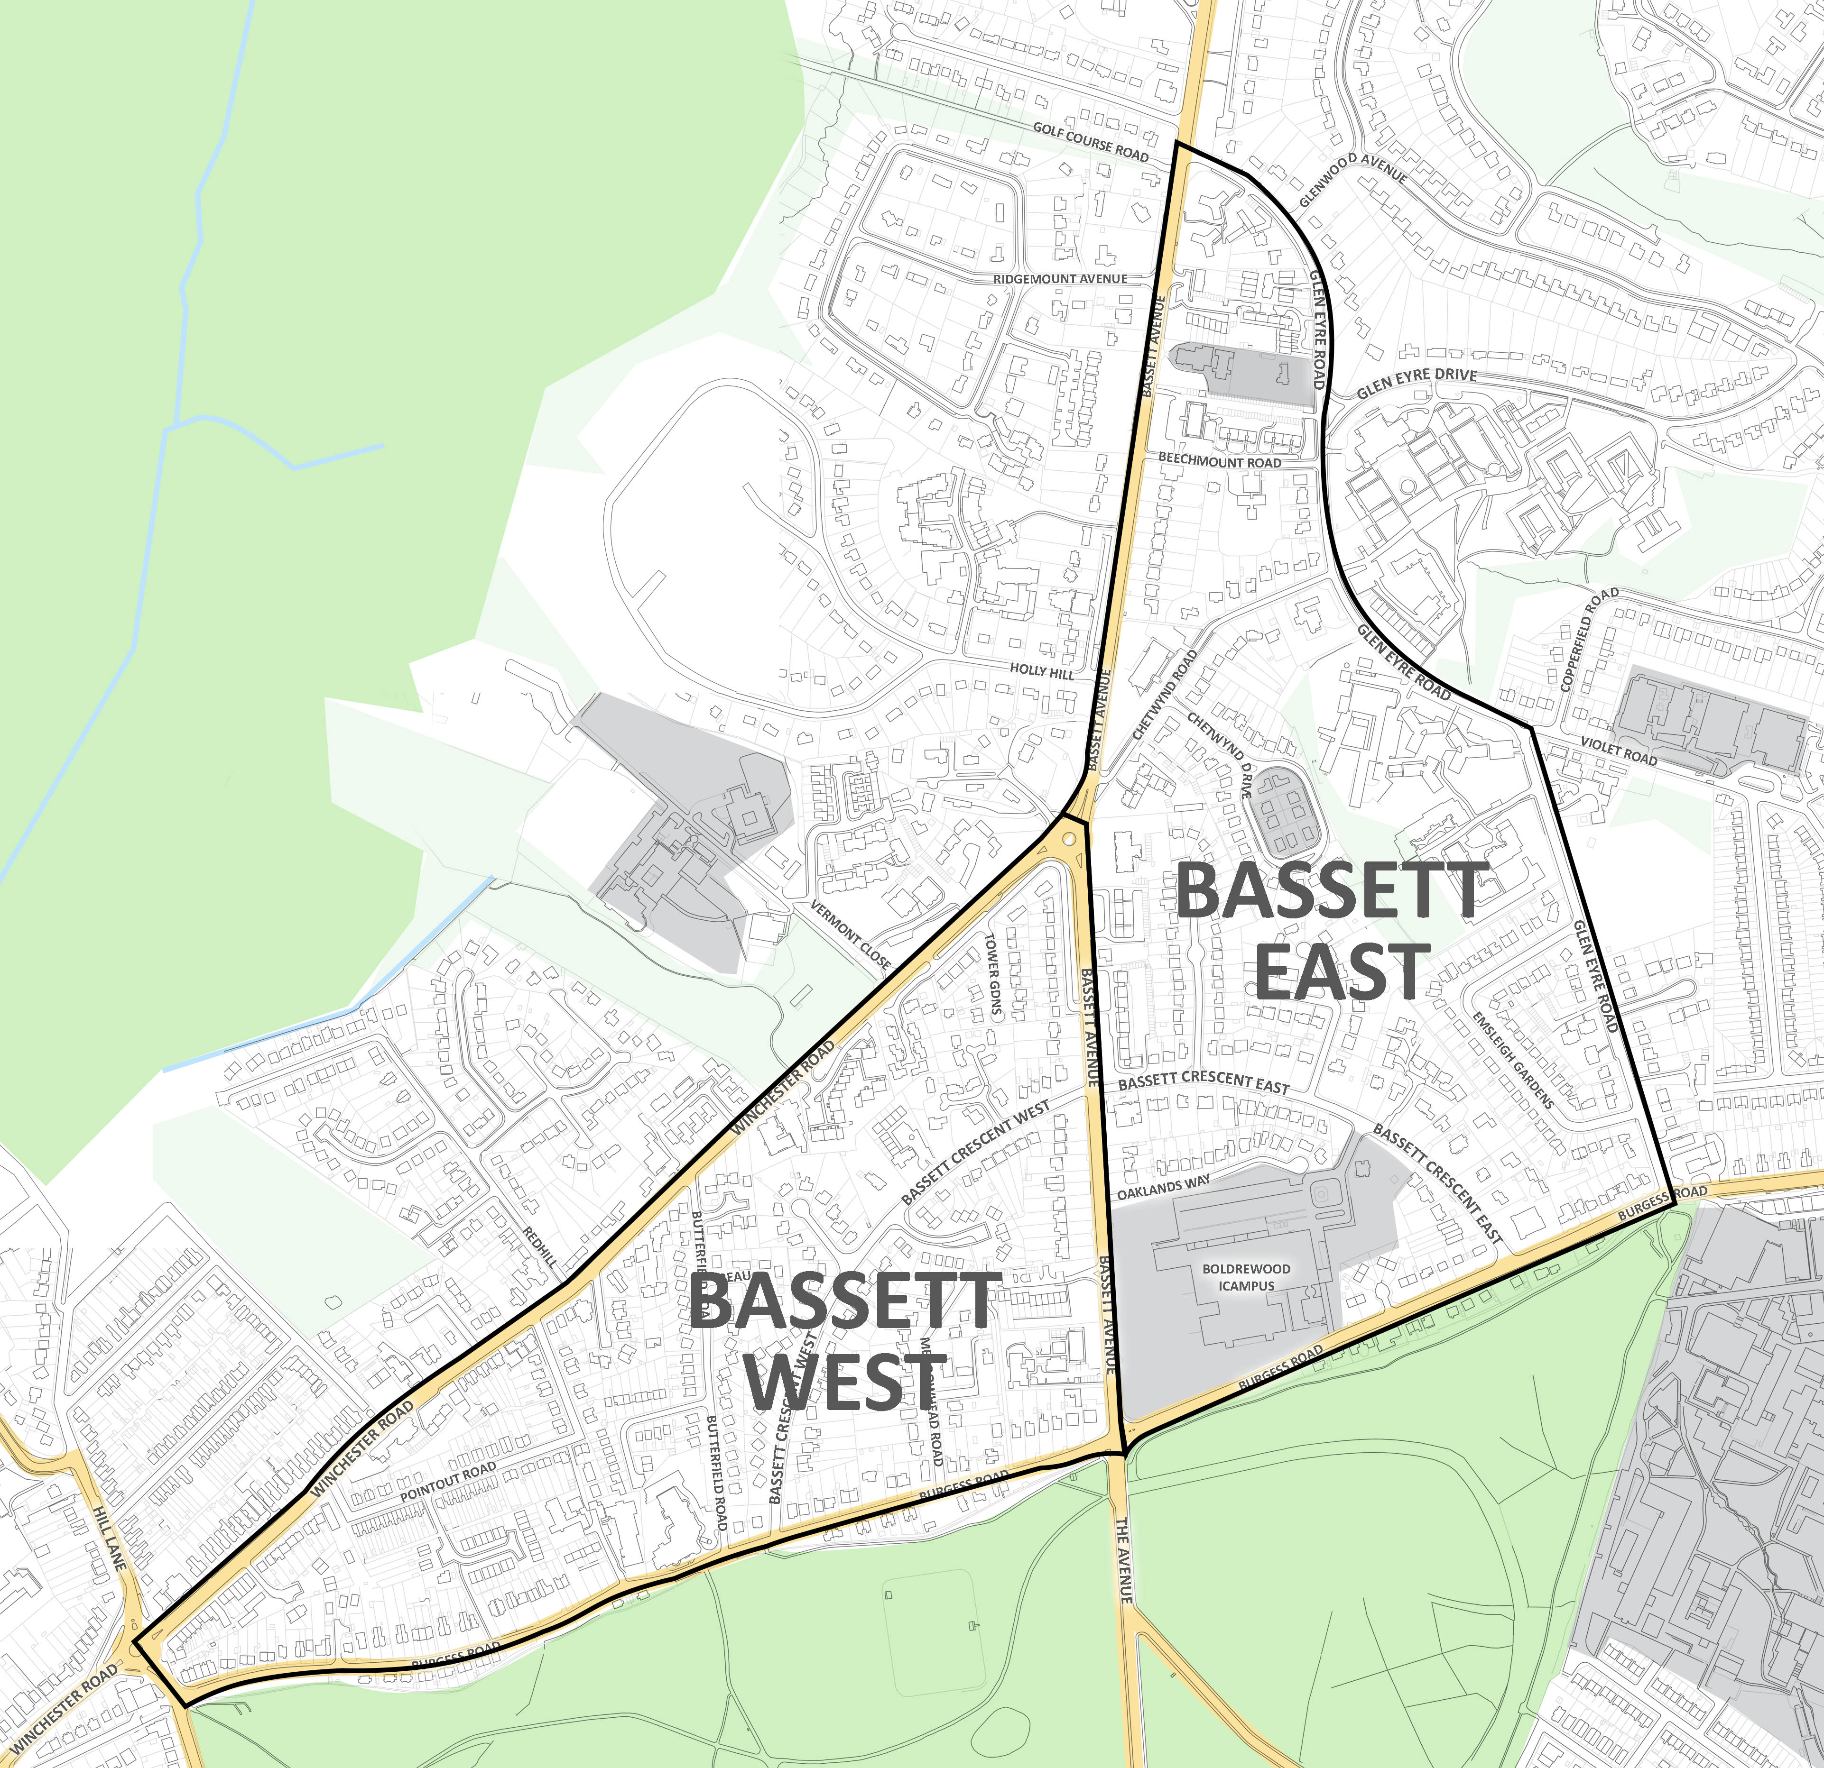
Bassett East & West Proposed safety scheme survey
Friday, October 15, 2021
169
Total Responses

Slide 2
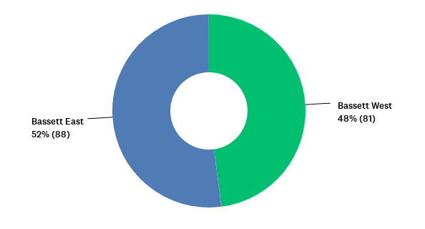
Q1: Which location do you want to feedback on? Please note you will have the opportunity to feedback on both areas.
Answered: 169 Skipped: 0

Slide 3
Q1: Which location do you want to feedback on? Please note you will have the opportunity to feedback on both areas.
Answered: 169 Skipped: 0

Slide 4
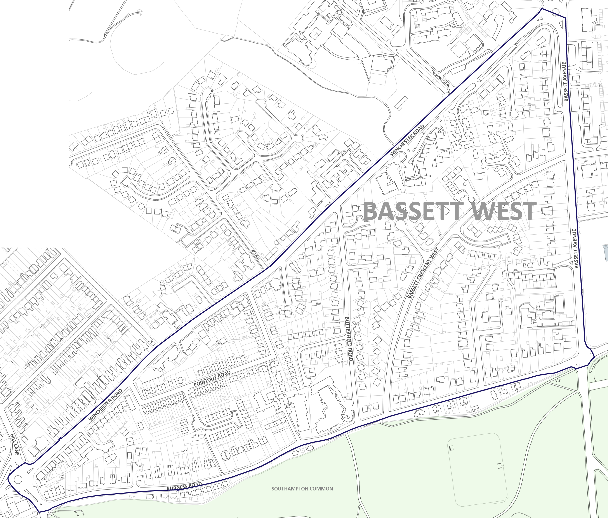
Bassett West Results

Slide 5
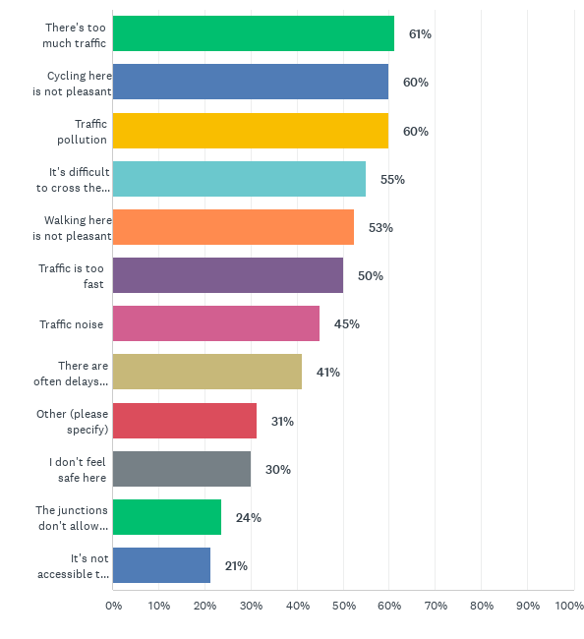
Q2: What don't you like about this location?
Answered: 80 Skipped: 89
Bassett West Results

Slide 6
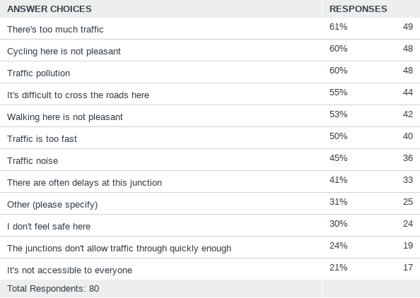
Q2: What don't you like about this location?
Answered: 80 Skipped: 89
Bassett West Results

Slide 7
Q2: What don't you like about this location? These are the responses to other comment box which have been tagged into themes
Bassett West Results

Slide 8
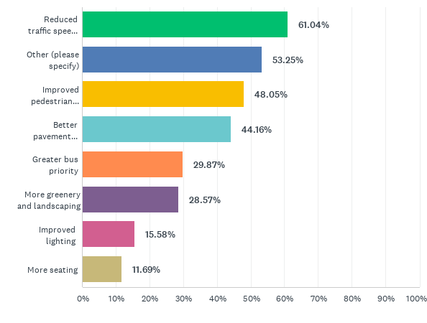
Q3: What would you like to improve at this location?
Answered: 77 Skipped: 92
Bassett West Results

Slide 9
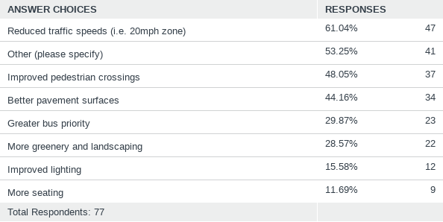
Q3: What would you like to improve at this location?
Answered: 77 Skipped: 92
Bassett West Results

Slide 10
Q3: What would you like to improve at this location? These are the responses to other comment box which have been tagged into themes
Bassett West Results

Slide 11
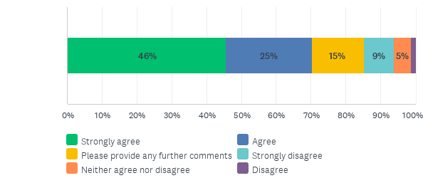
Q4: To what extent do you agree or disagree with the council’s proposal to improve safety and reduce through traffic and traffic speeds in your area?
Answered: 81 Skipped: 88
Bassett West Results

Slide 12
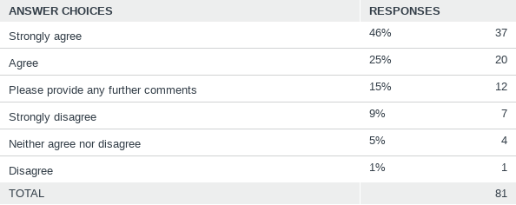
Q4: To what extent do you agree or disagree with the council’s proposal to improve safety and reduce through traffic and traffic speeds in your area?
Answered: 81 Skipped: 88
Bassett West Results

Slide 13
Q4: To what extent do you agree or disagree with the council’s proposal to improve safety and reduce through traffic and traffic speeds in your area? These are the responses to other comment box which have been tagged into themes
Bassett West Results

Slide 14
Q5: Thinking about the proposed changes, to what extent do you agree or disagree with the following statements?
Answered: 78 Skipped: 91
Bassett West Results

Slide 15
Q5: Thinking about the proposed changes, to what extent do you agree or disagree with the following statements?
Answered: 78 Skipped: 91
Bassett West Results

Slide 16
Q5: Thinking about the proposed changes, to what extent do you agree or disagree with the following statements?
Answered: 78 Skipped: 91
Bassett West Results

Slide 17
Q5: Thinking about the proposed changes, to what extent do you agree or disagree with the following statements?
Answered: 78 Skipped: 91
Bassett West Results

Slide 18
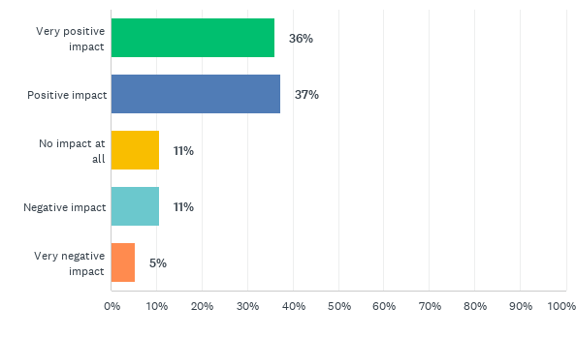
Q6: If the proposals were to be implemented, what impact do you feel this may have on you, local businesses or the wider community?
Answered: 75 Skipped: 94
Bassett West Results

Slide 19
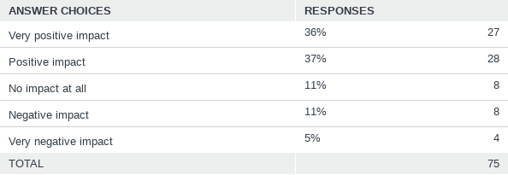
Q6: If the proposals were to be implemented, what impact do you feel this may have on you, local businesses or the wider community?
Answered: 75 Skipped: 94
Bassett West Results

Slide 20
Q7: Please provide any further feedback to improve walking and cycling in this area. These are the responses to other comment box which have been tagged into themes
Bassett West Results

Slide 21
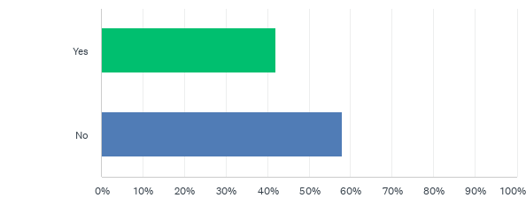
Q8: Do you want to feedback on any other schemes?
Answered: 81 Skipped: 88

Slide 22
Q8: Do you want to feedback on any other schemes?
Answered: 81 Skipped: 88

Slide 23
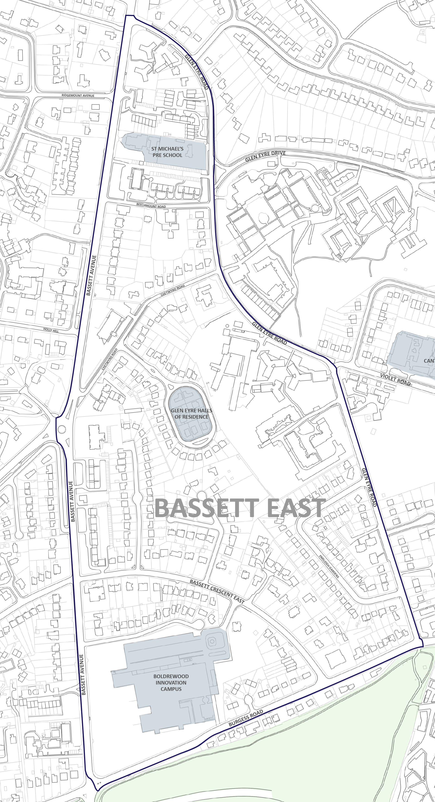
Bassett East Results

Slide 24
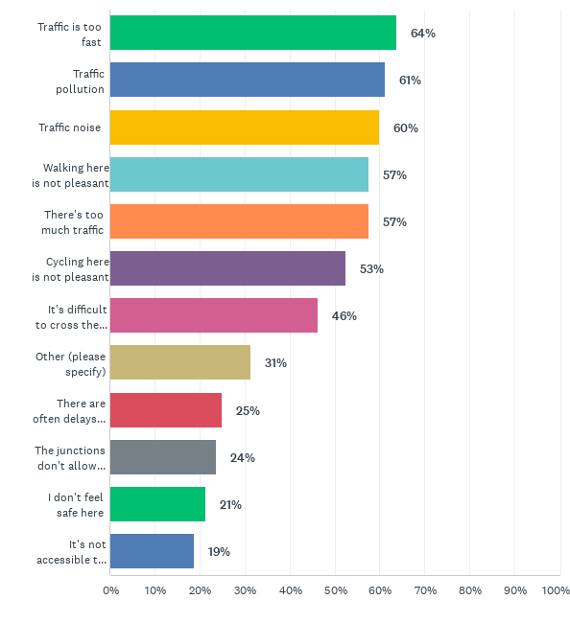
Q9: What don't you like about this location?
Answered: 80 Skipped: 89
Bassett East Results

Slide 25
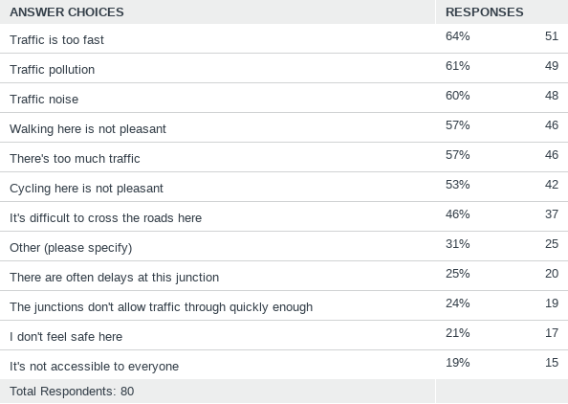
Q9: What don't you like about this location?
Answered: 80 Skipped: 89
Bassett East Results

Slide 26
Q9: What don't you like about this location? These are the responses to other comment box which have been tagged into themes
Bassett East Results

Slide 27
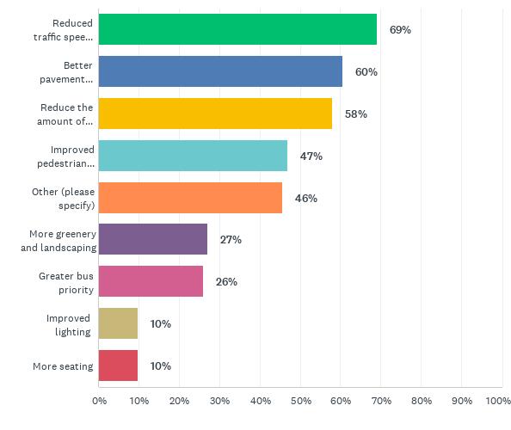
Q10: What would you like to improve at this location?
Answered: 81 Skipped: 88
Bassett East Results

Slide 28
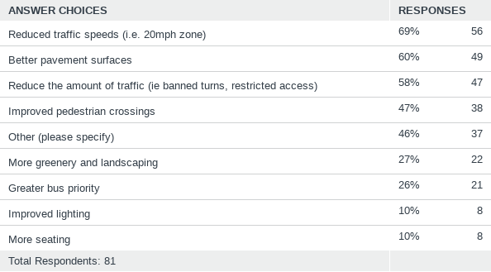
Q10: What would you like to improve at this location?
Answered: 81 Skipped: 88
Bassett East Results

Slide 29
Q10: What would you like to improve at this location? These are the responses to other comment box which have been tagged into themes
Bassett East Results

Slide 30
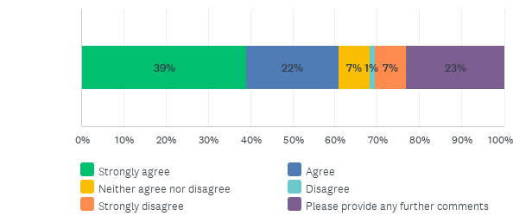
Q11: To what extent do you agree or disagree with the council’s proposal to improve safety and reduce through traffic and traffic speeds in your area?
Answered: 82 Skipped: 87
Bassett East Results

Slide 31
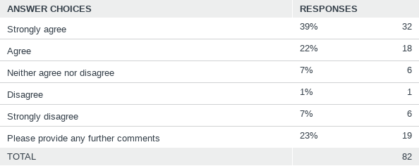
Q11: To what extent do you agree or disagree with the council’s proposal to improve safety and reduce through traffic and traffic speeds in your area?
Answered: 82 Skipped: 87
Bassett East Results

Slide 32
Q11: To what extent do you agree or disagree with the council’s proposal to improve safety and reduce through traffic and traffic speeds in your area? These are the responses to other comment box which have been tagged into themes
Bassett East Results

Slide 33
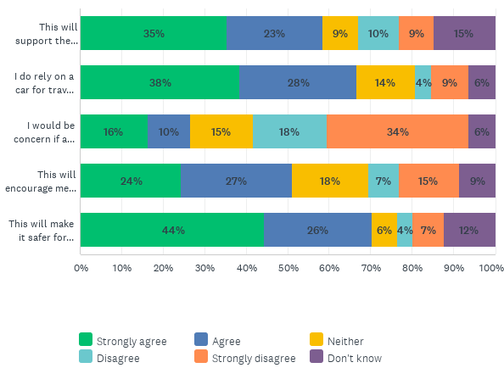
Q12: Thinking about the proposed changes, to what extent do you agree or disagree with the following statements?
Answered: 82 Skipped: 87
Bassett East Results

Slide 34
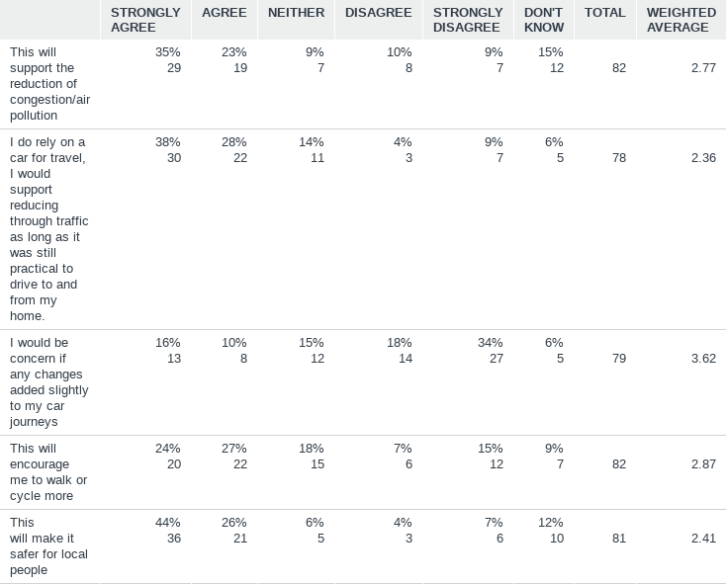
Q12: Thinking about the proposed changes, to what extent do you agree or disagree with the following statements?
Answered: 82 Skipped: 87
Bassett East Results

Slide 35
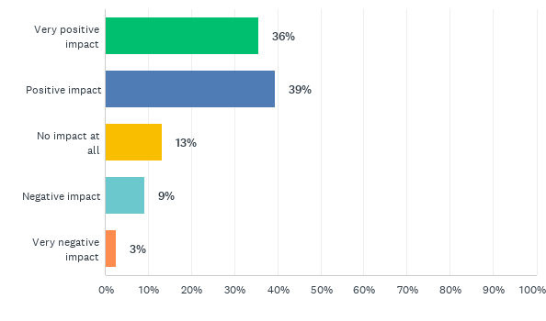
Q13: If the proposals were to be implemented, what impact do you feel this may have on you, local businesses or the wider community?
Answered: 76 Skipped: 93
Bassett East Results

Slide 36
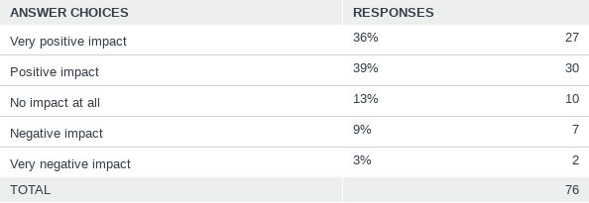
Q13: If the proposals were to be implemented, what impact do you feel this may have on you, local businesses or the wider community?
Answered: 76 Skipped: 93
Bassett East Results

Slide 37
Q14: Please provide any further feedback to improve walking and cycling in this area. These are the responses to other comment box which have been tagged into themes
Bassett East Results

Slide 38
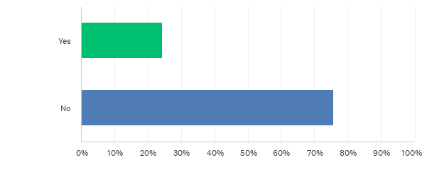
Q15: Do you want to feedback on any other schemes?
Answered: 82 Skipped: 87
Bassett East Results

Slide 39
Q15: Do you want to feedback on any other schemes?
Answered: 82 Skipped: 87
Bassett East Results

Slide 40
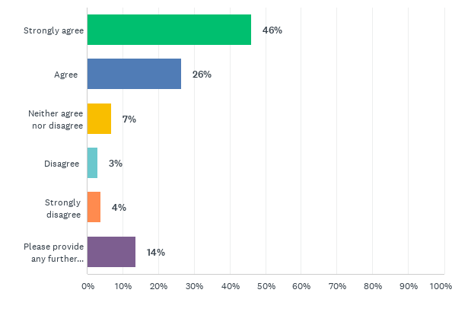
Q16: To what extent do you agree or disagree with the council's commitment to encouraging sustainable travel by improving bus, pedestrian and cycle routes?
Answered: 102 Skipped: 67
About You Results

Slide 41
Q16: To what extent do you agree or disagree with the council's commitment to encouraging sustainable travel by improving bus, pedestrian and cycle routes?
Answered: 102 Skipped: 67
About You Results

Slide 42
Q16: To what extent do you agree or disagree with the council's commitment to encouraging sustainable travel by improving bus, pedestrian and cycle routes? These are the responses to other comment box which have been tagged into themes
About You Results

Slide 43
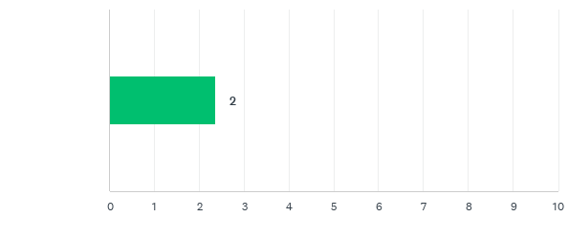
Q17: Average number of bicycles per household
Answered: 101 Skipped: 68
About You Results

Slide 44
Q17: Average number of bicycles per household
Answered: 101 Skipped: 68
About You Results

